Slide 1
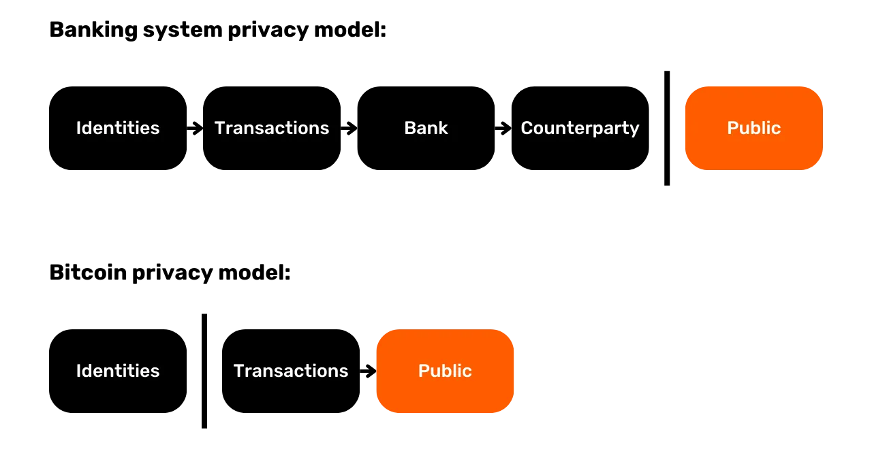
Banking System privacy model:
Identities
Transactions
Bank
Counterparty
Public
Banking privacy model:
Identities
Transactions
Public

Slide 2
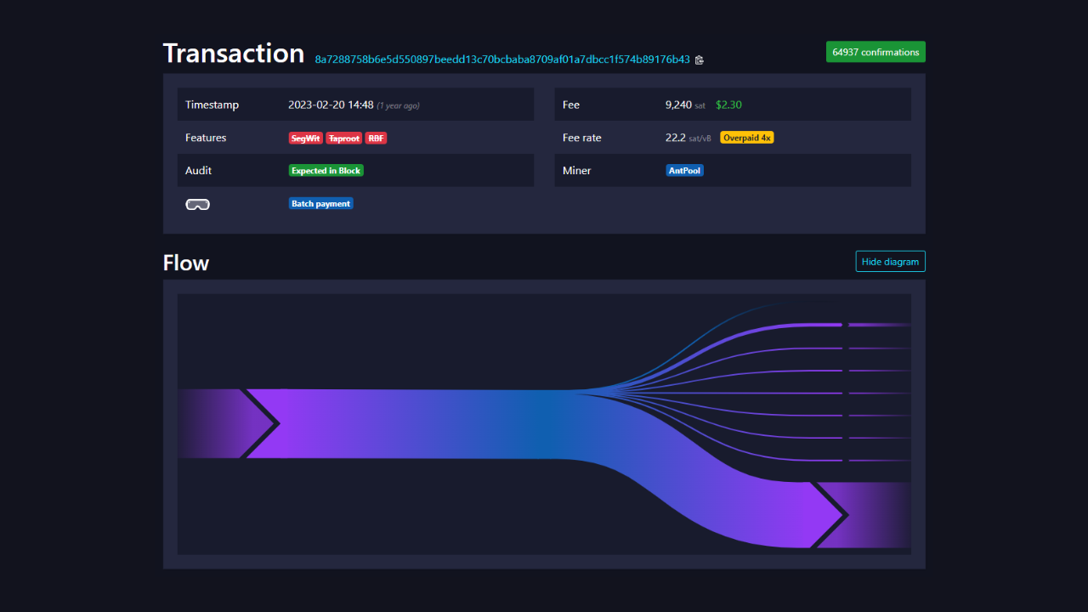

Slide 3
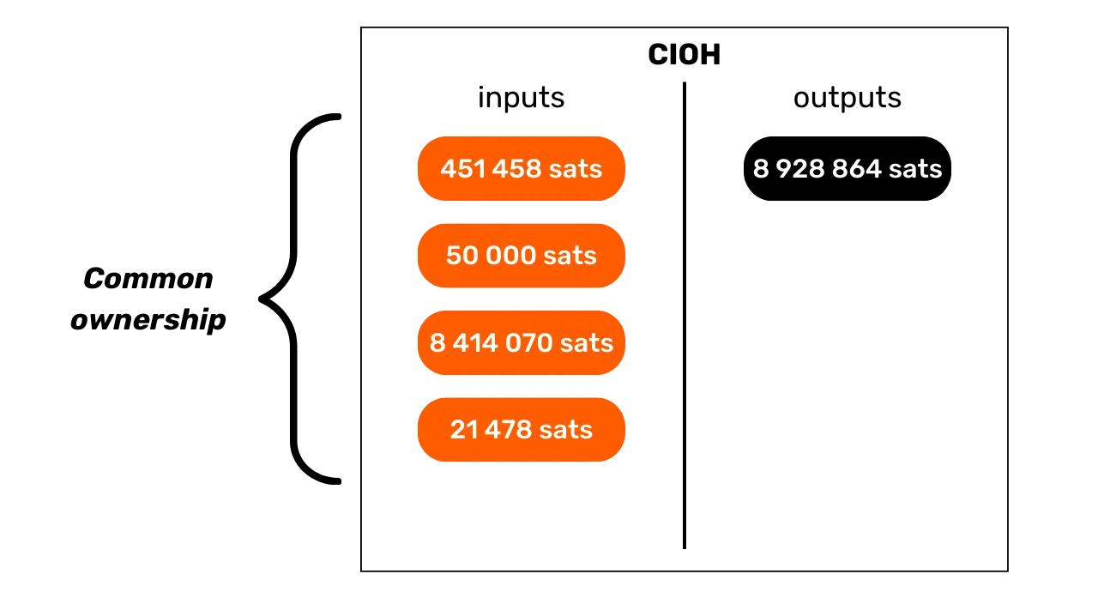
inputs
outputs
Common
Ownership

Slide 4
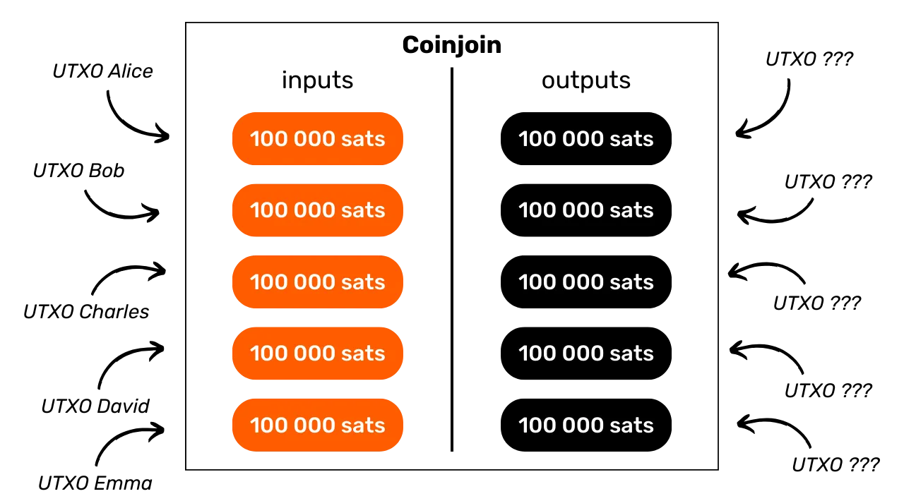
inputs
outputs

Slide 5
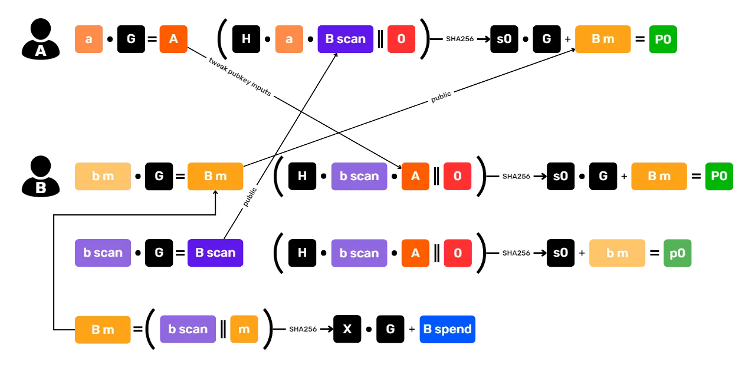

Slide 6
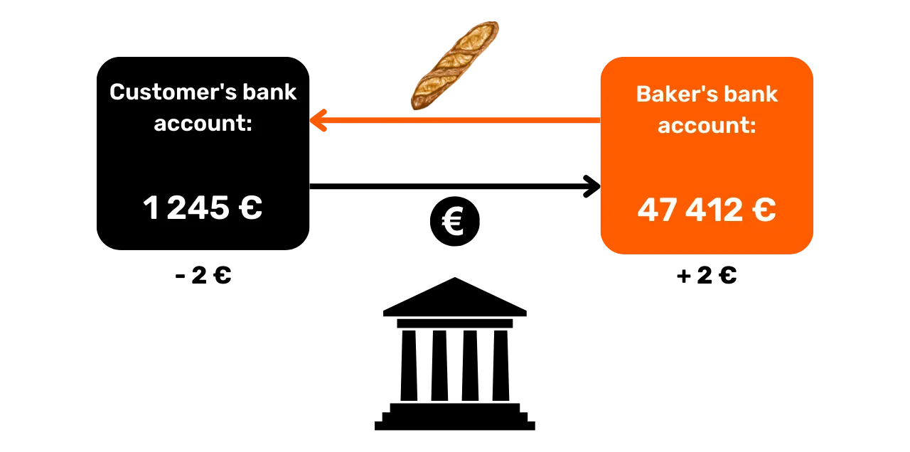
Customer’s bank account
Baker’s bank account

Slide 7
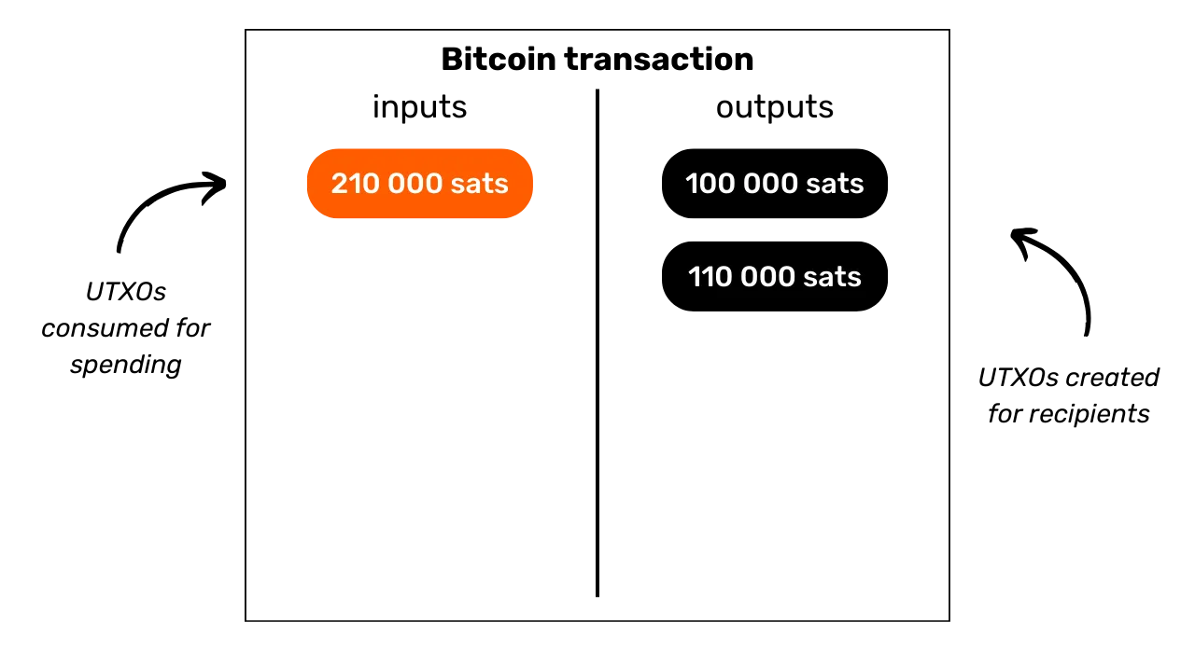
Bitcoin transaction
inputs
outputs
UTXOs
consumed for
spending
UTXO created
for recipients

Slide 8
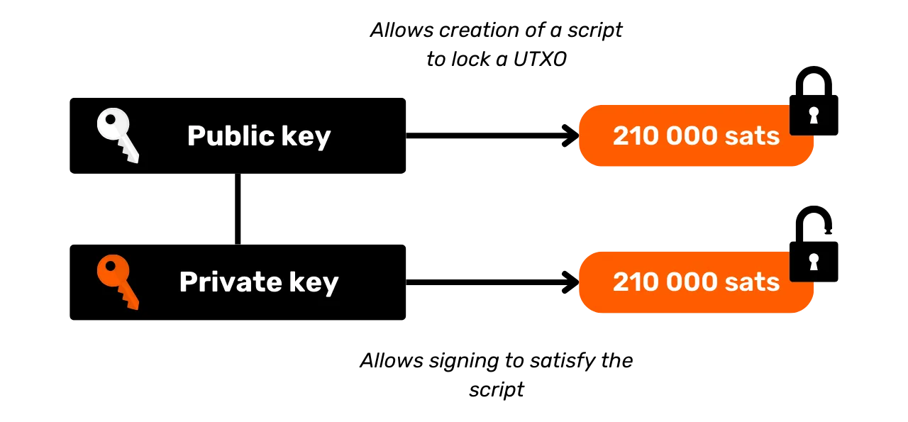
Allows creation of a script
To lock a UTXO
Public Key
Public Key
Private Key
Allows signing to satisfy the script

Slide 9
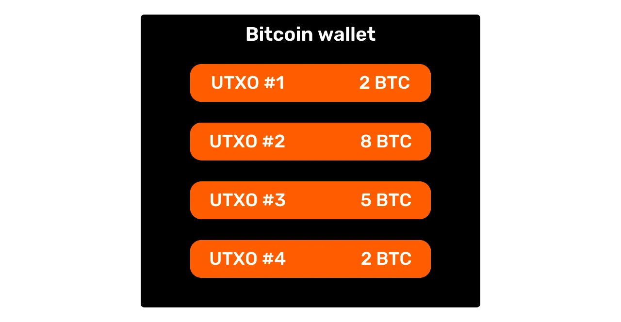
Bitcoin wallet

Slide 10
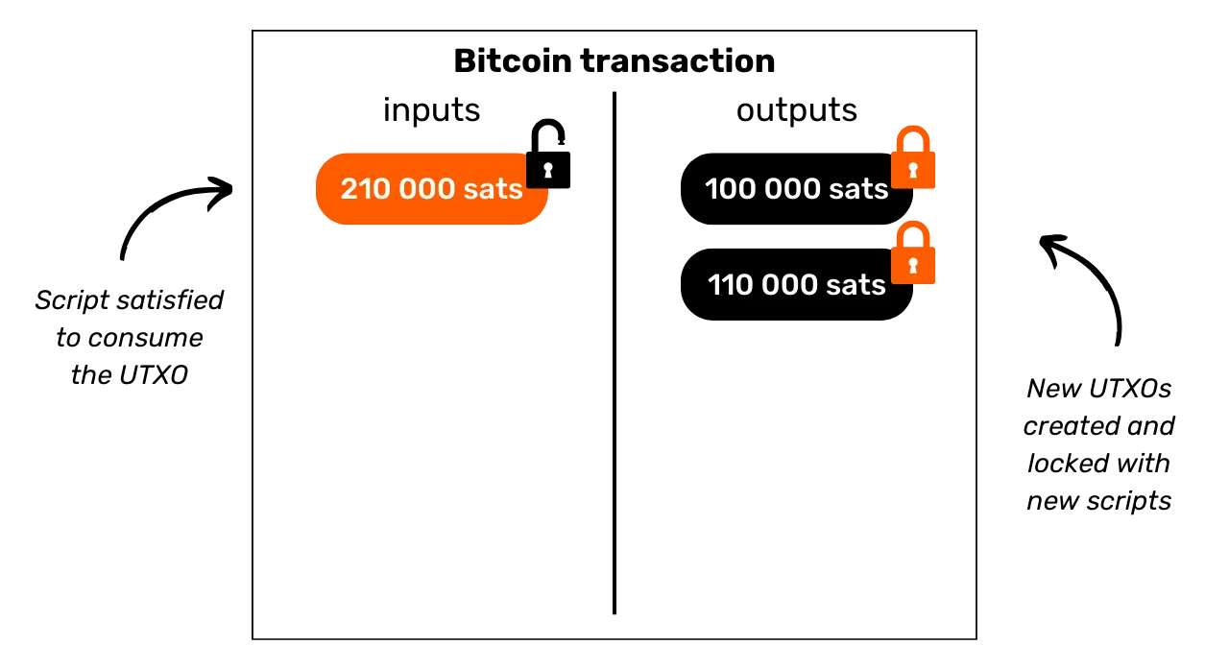
Bitcoin transaction
inputs
outputs
Script satisfied
to consume
the UTXO
New UTXOs
created and
locked with
new scripts

Slide 11
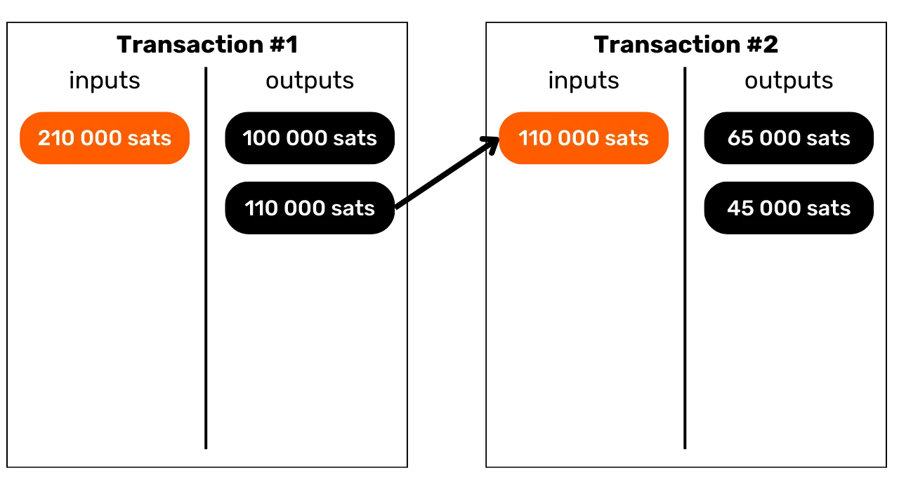
Transaction#1
Transaction#2
inputs
outputs
inputs
outputs

Slide 12
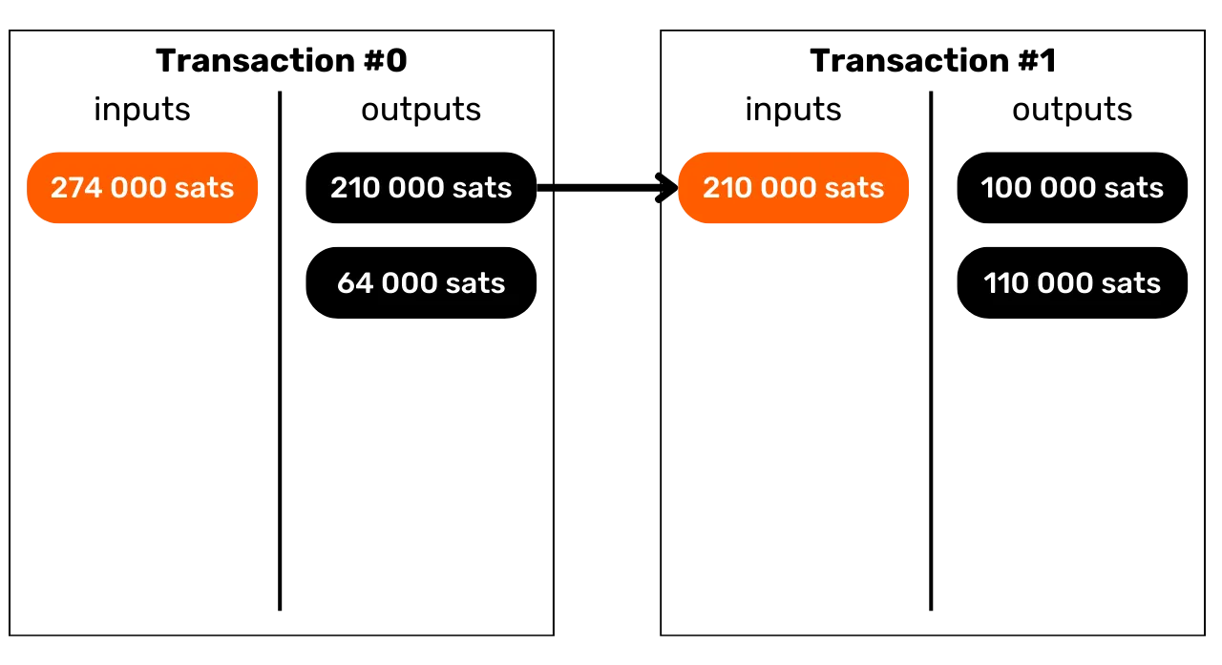
Transaction#0
Transaction#0
Transaction#1
inputs
outputs
inputs
outputs

Slide 13
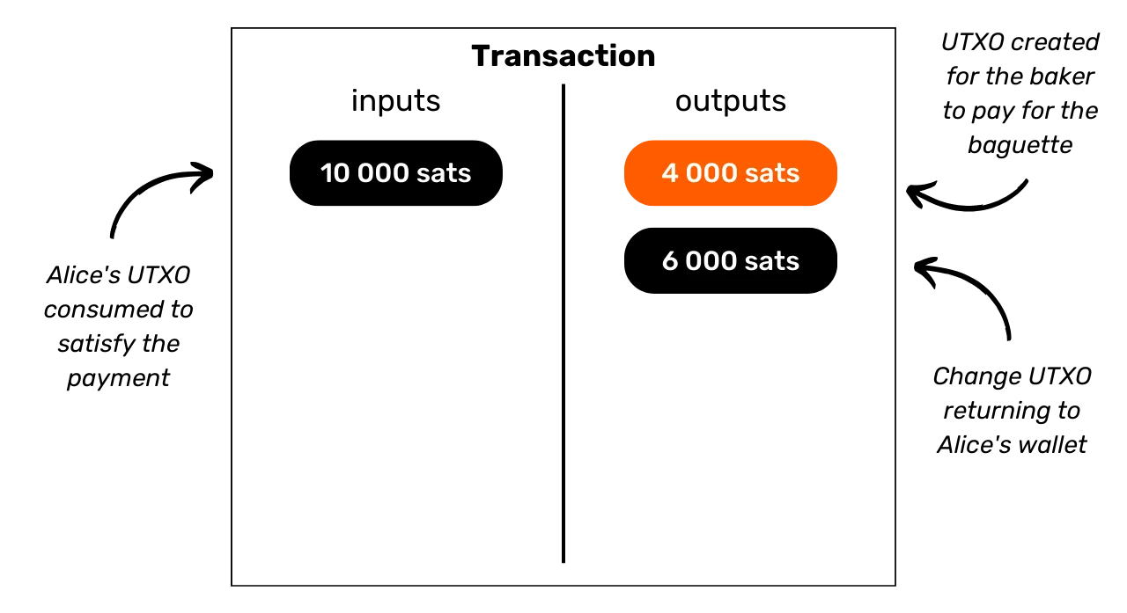
Transaction
inputs
outputs
Alice’s UTXO
consumed to
satisfy the
payment
Change UTXO
returning to
Alice’s wallet

Slide 14
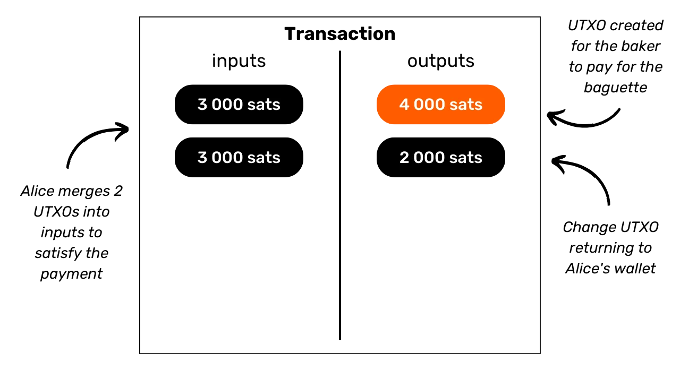
Transaction
UTXO created
for the baker
to pay for the
baguette
inputs
outputs
Alice merges 2
UTXOs into
inputs to
satisfy the
payment
Change
UTXOs returning to Alice’s wallet

Slide 15
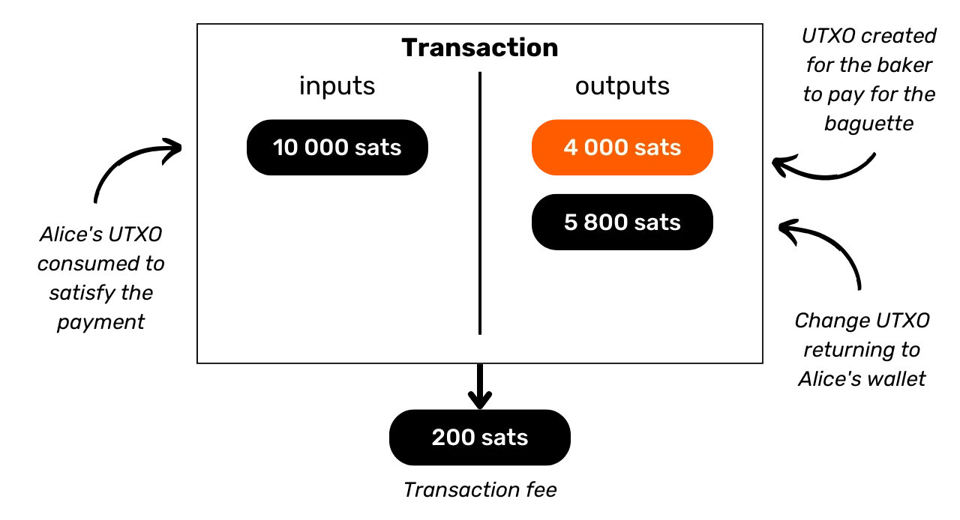
UTXO created
for the baker
to pay for the
baguette
Transaction
inputs
outputs
Alice’s UTXO consumed to
satisfy the
payment
Change
UTXOs returning to Alice’s wallet
Transaction fee

Slide 16
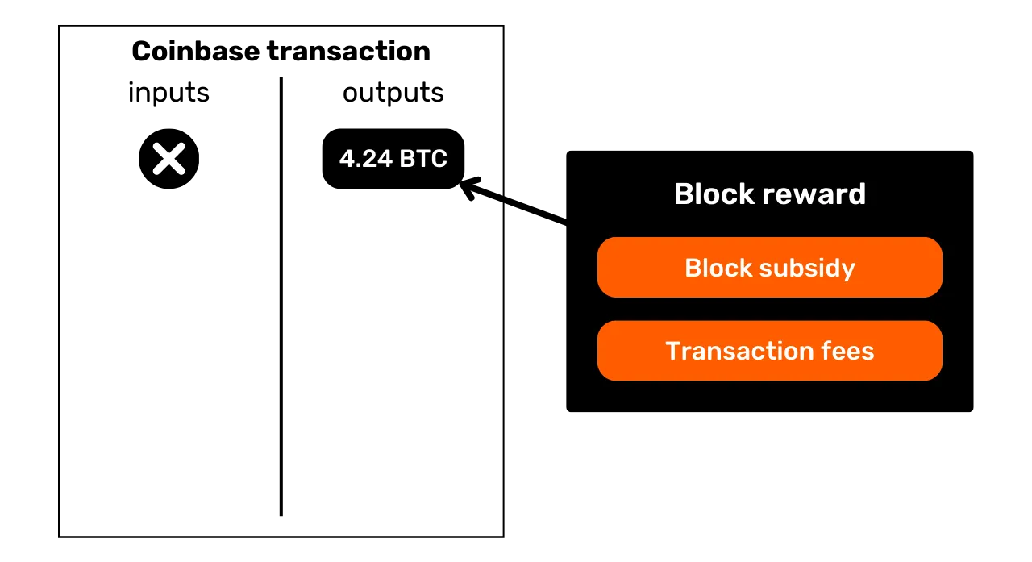
Coinbase transaction
inputs
outputs
Block reward
Block subsidy
Transaction fees

Slide 17
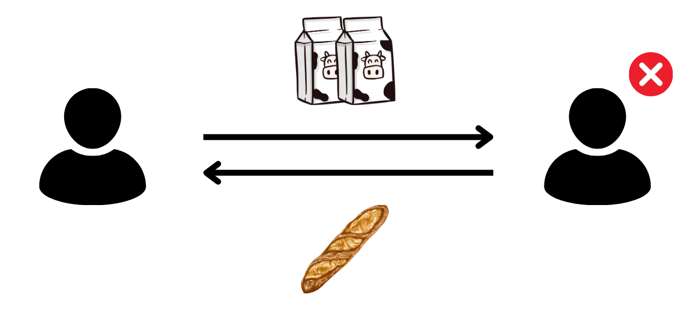

Slide 18
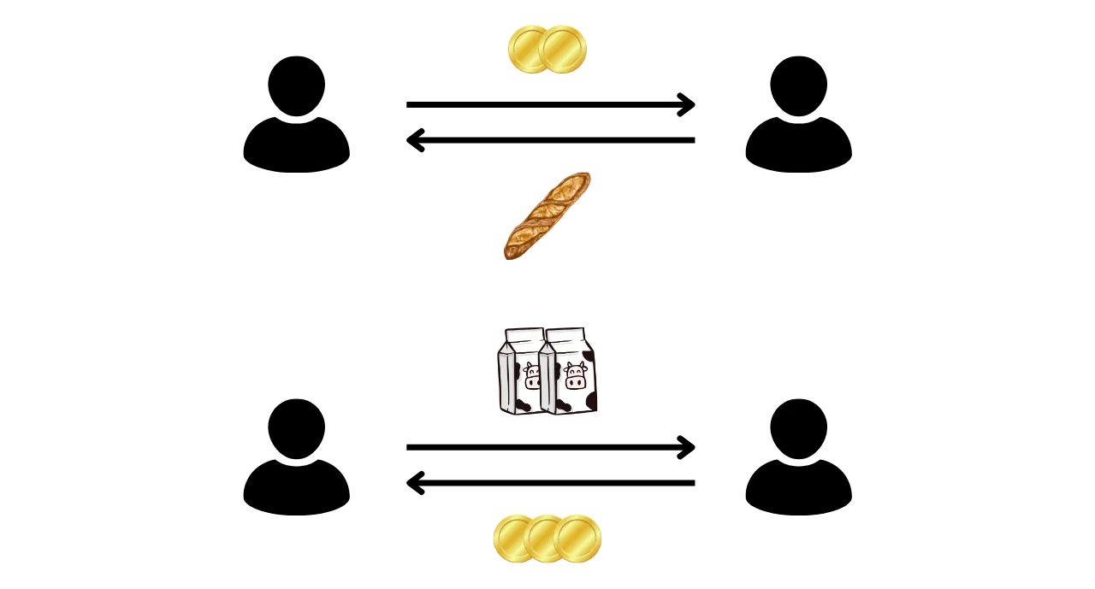

Slide 19
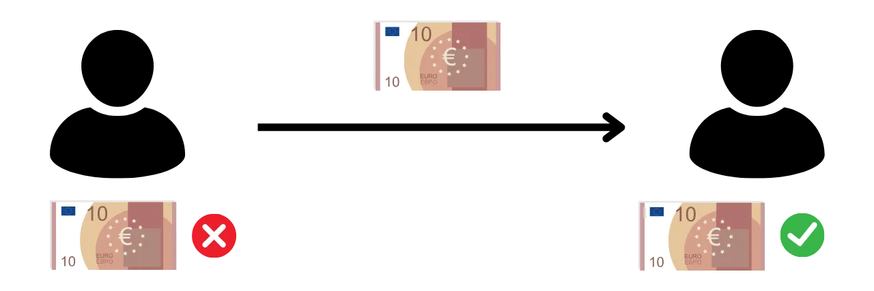

Slide 20
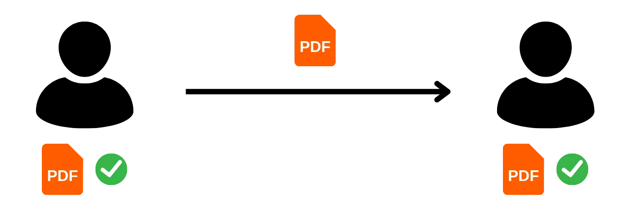

Slide 21
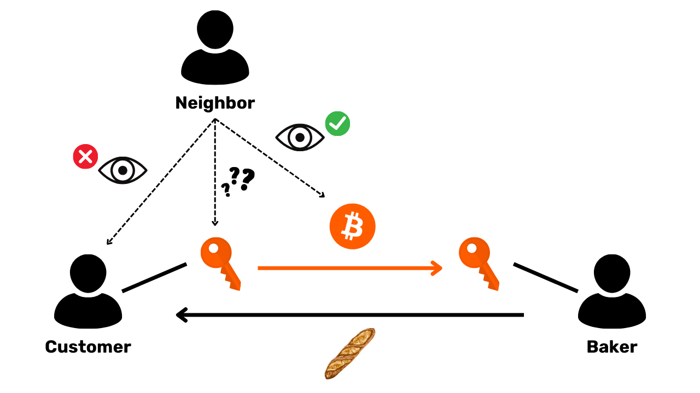
Neighbor
Customer
Baker

Slide 22
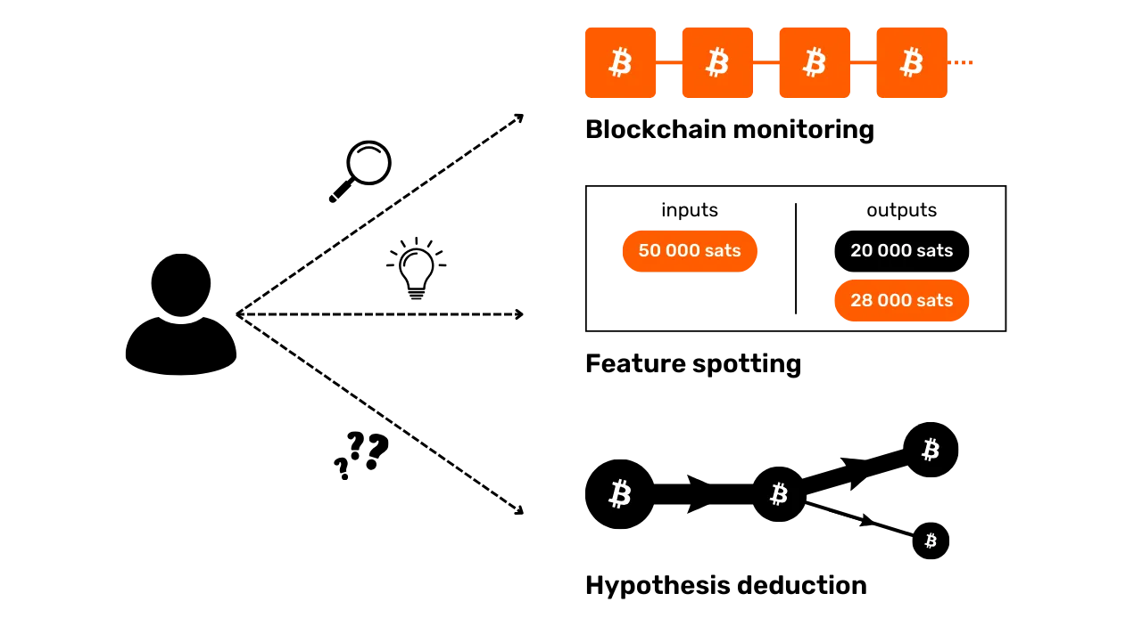
inputs
outputs
Feature spotting
Hypothesis deduction

Slide 23
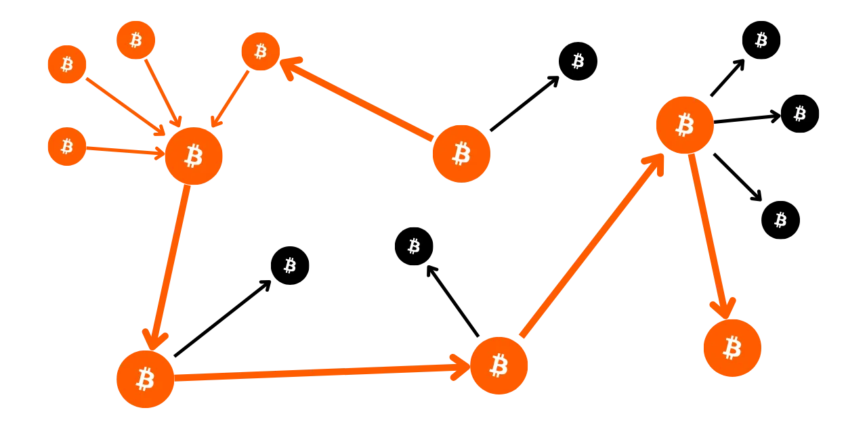

Slide 24
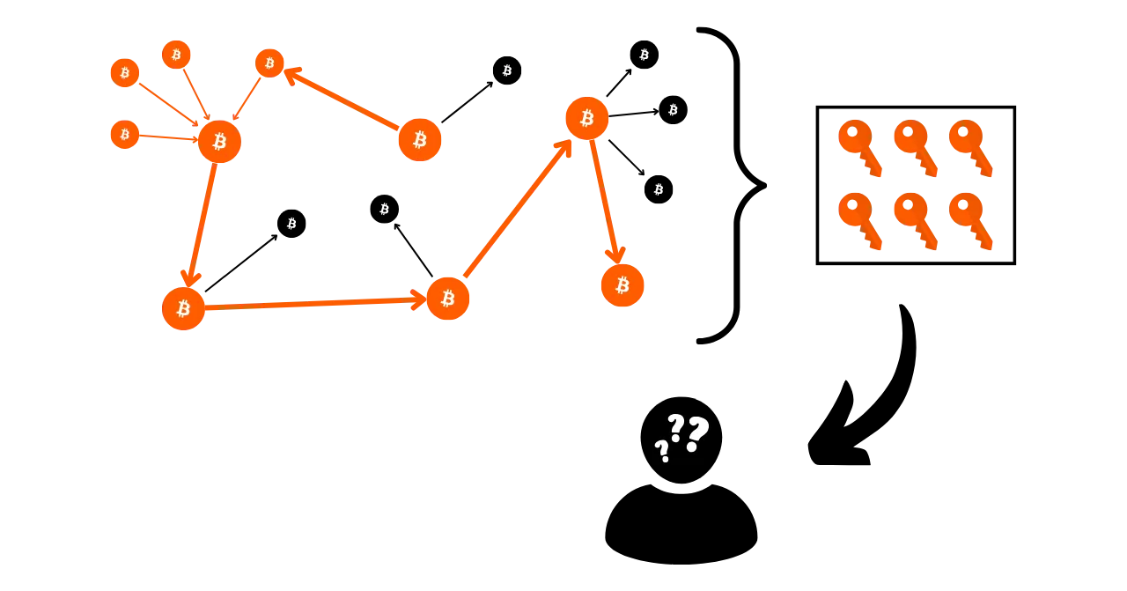

Slide 25
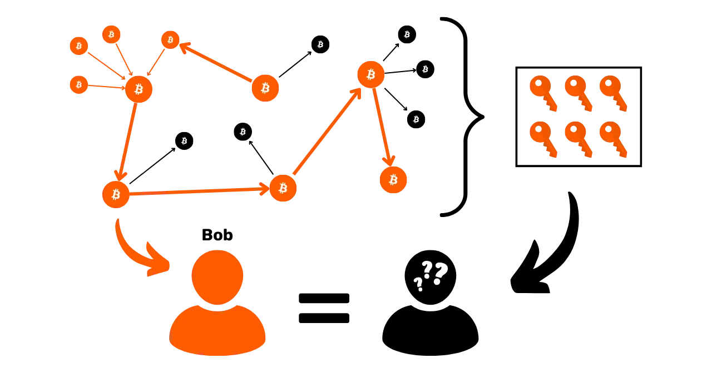

Slide 26
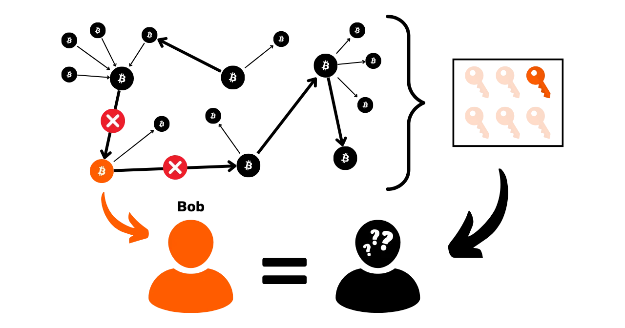

Slide 27
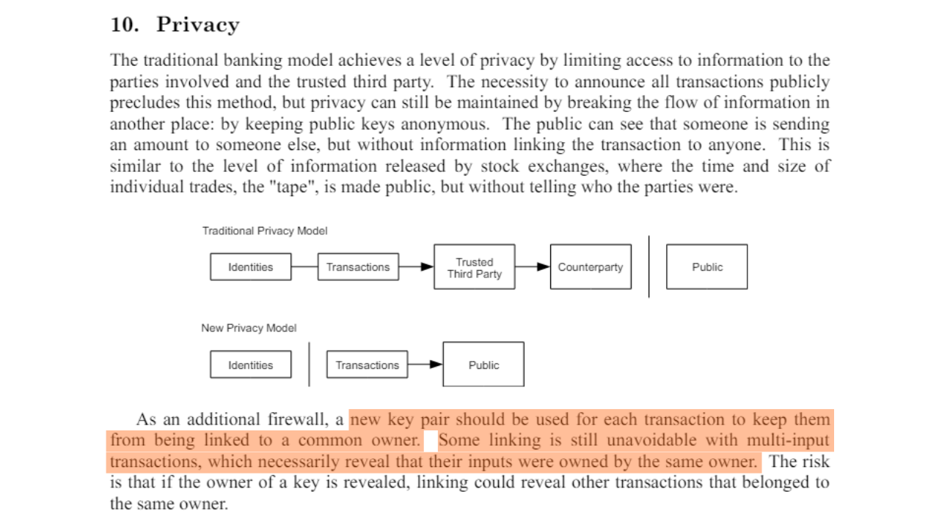

Slide 28
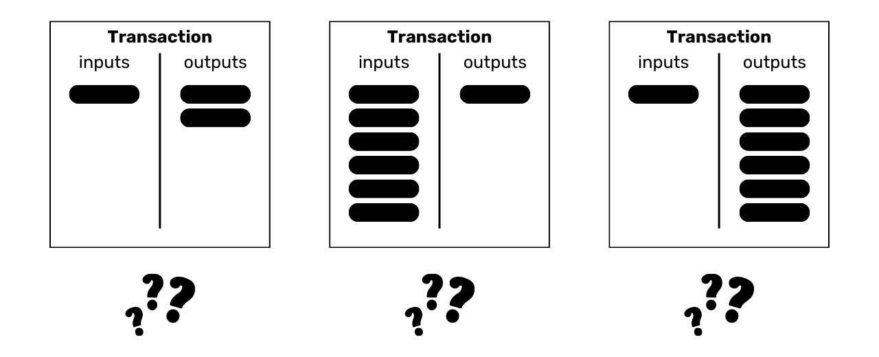
Transaction
Transaction
Transaction
inputs
outputs
inputs
outputs
inputs
outputs

Slide 29
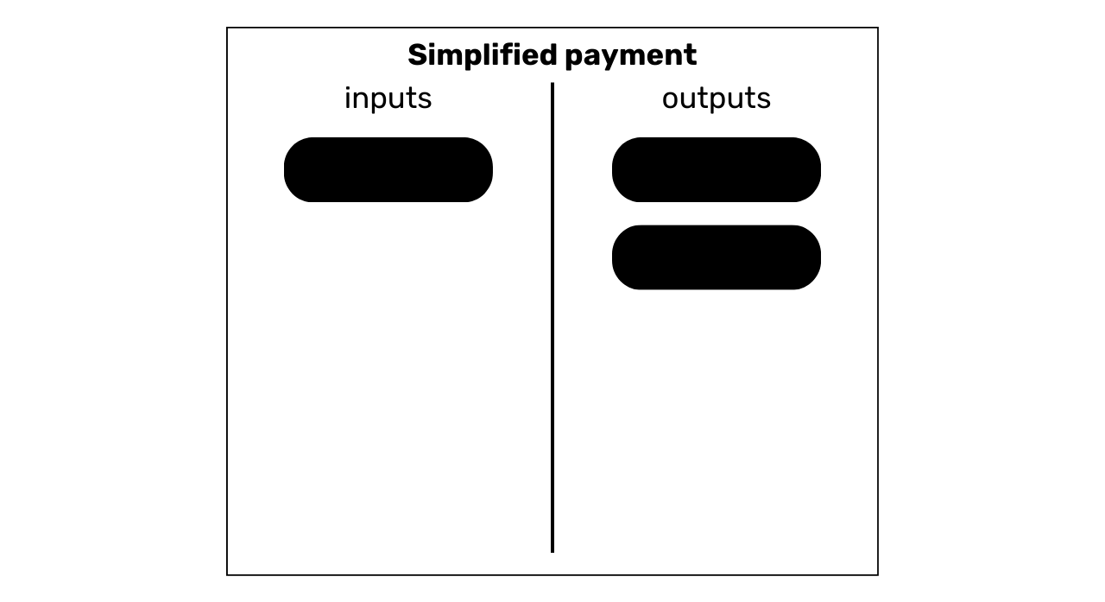
Simplified payment
inputs
outputs

Slide 30
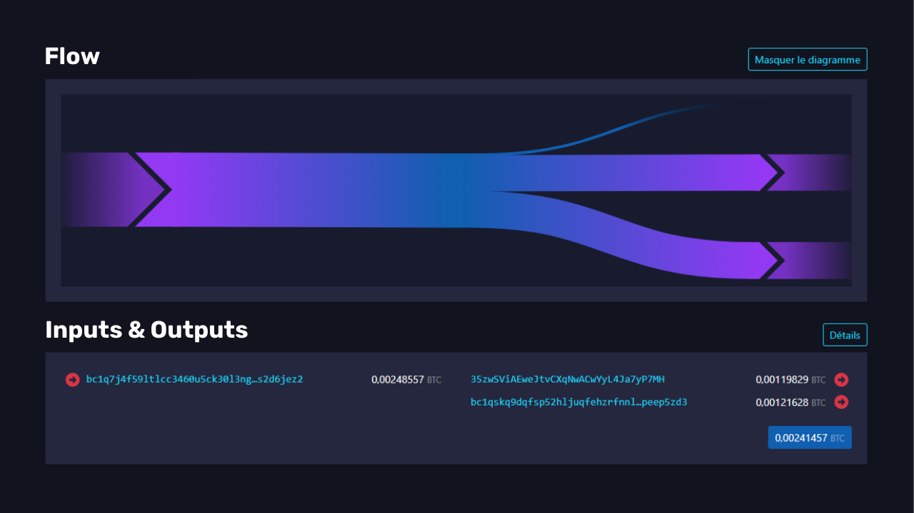

Slide 31
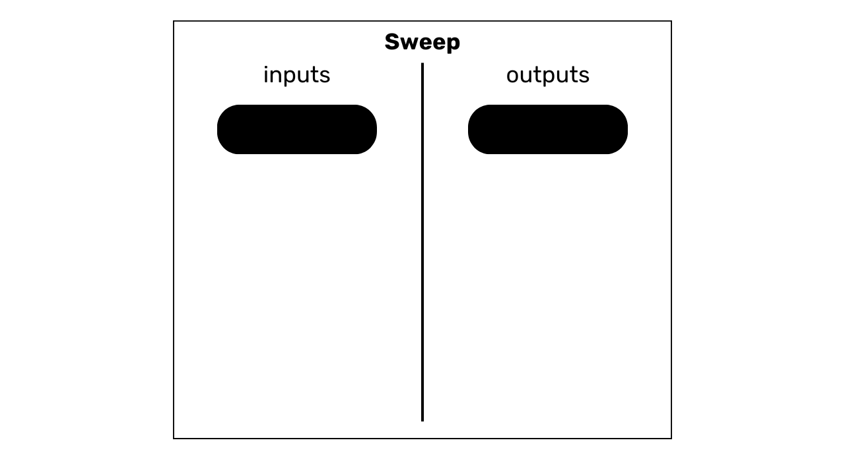
Sweep
inputs
outputs

Slide 32
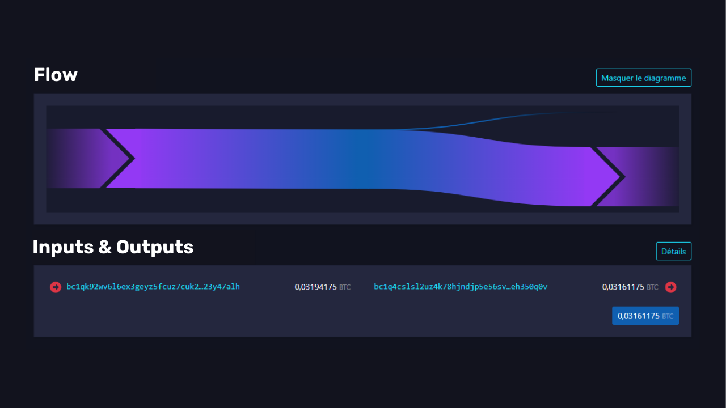

Slide 33
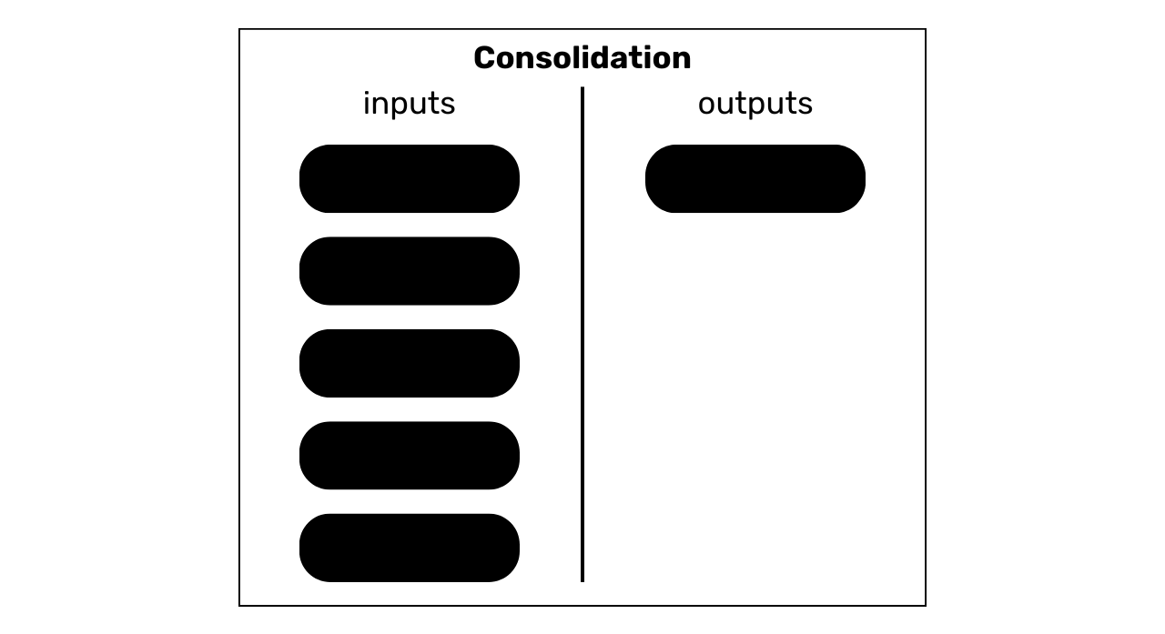
Consolidation
inputs
outputs

Slide 34
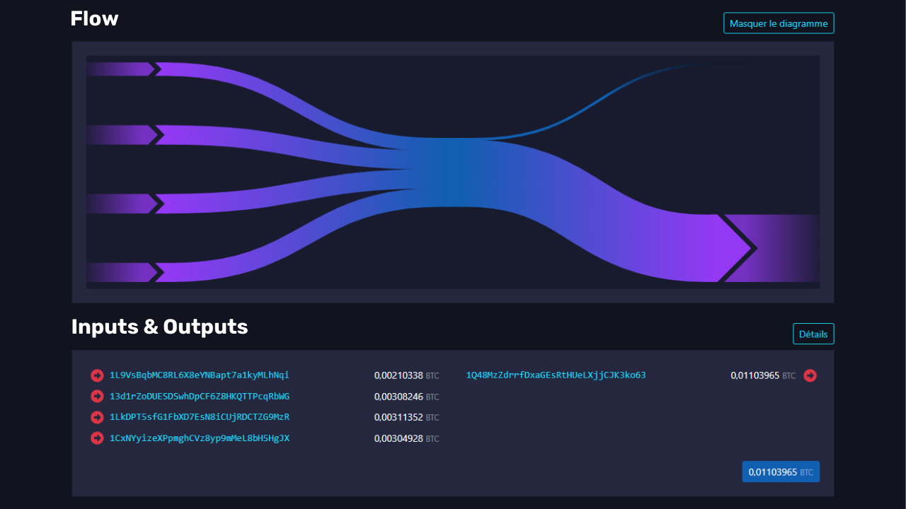

Slide 35
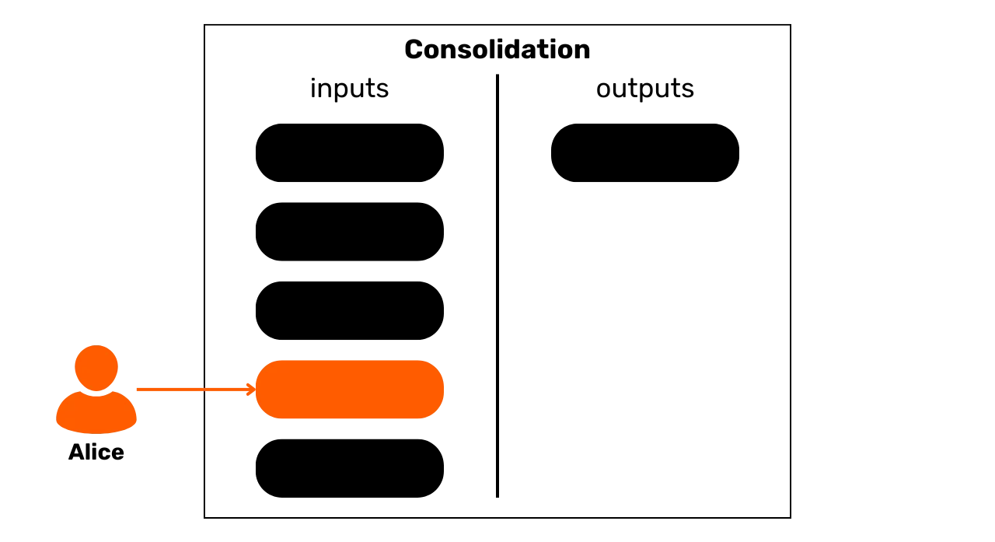
Consolidation
Consolidation
inputs
outputs

Slide 36
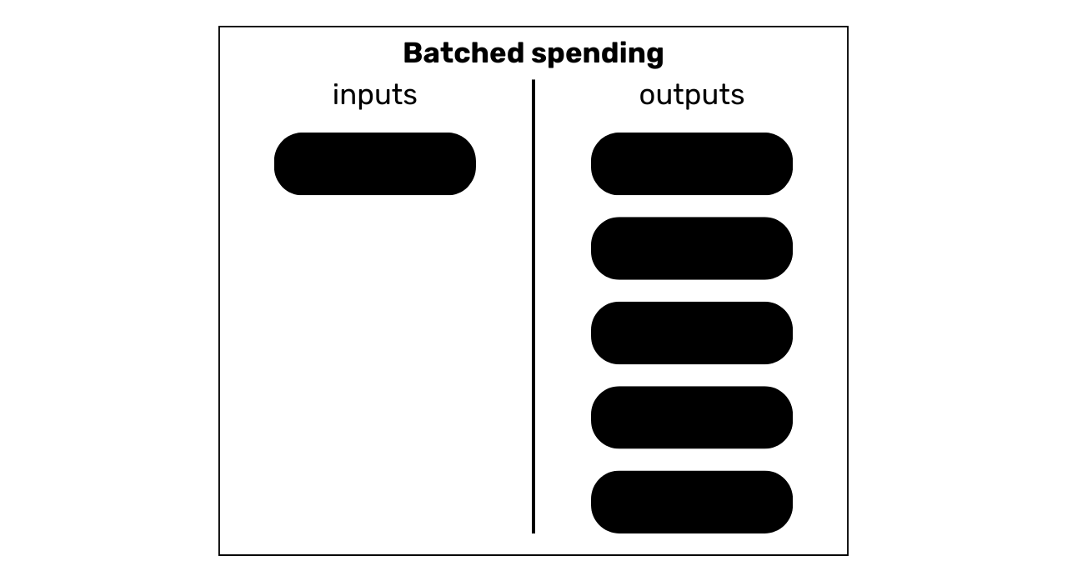
Batch spending
inputs
outputs

Slide 37
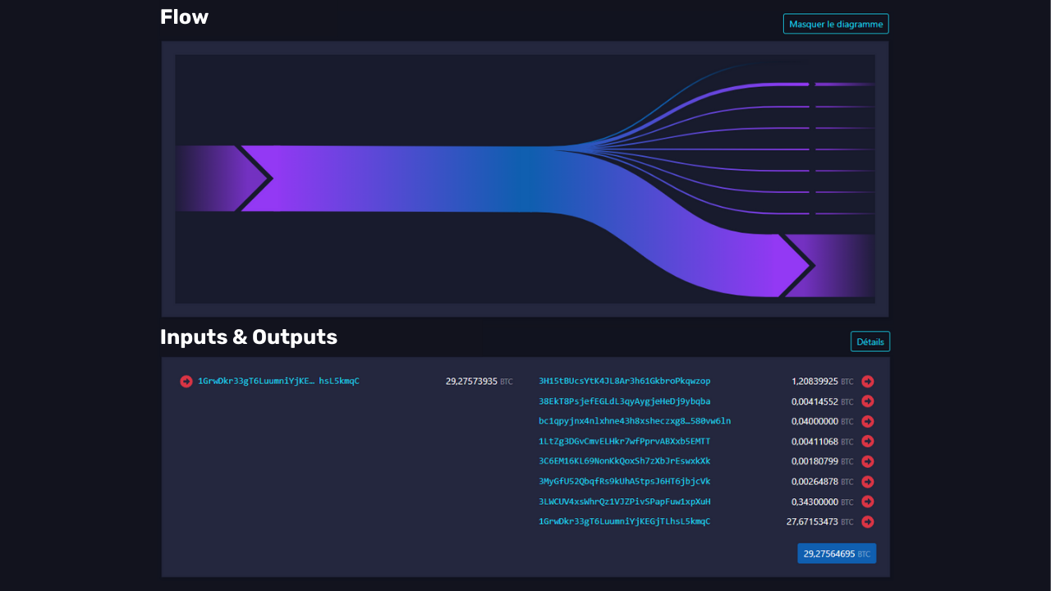

Slide 38
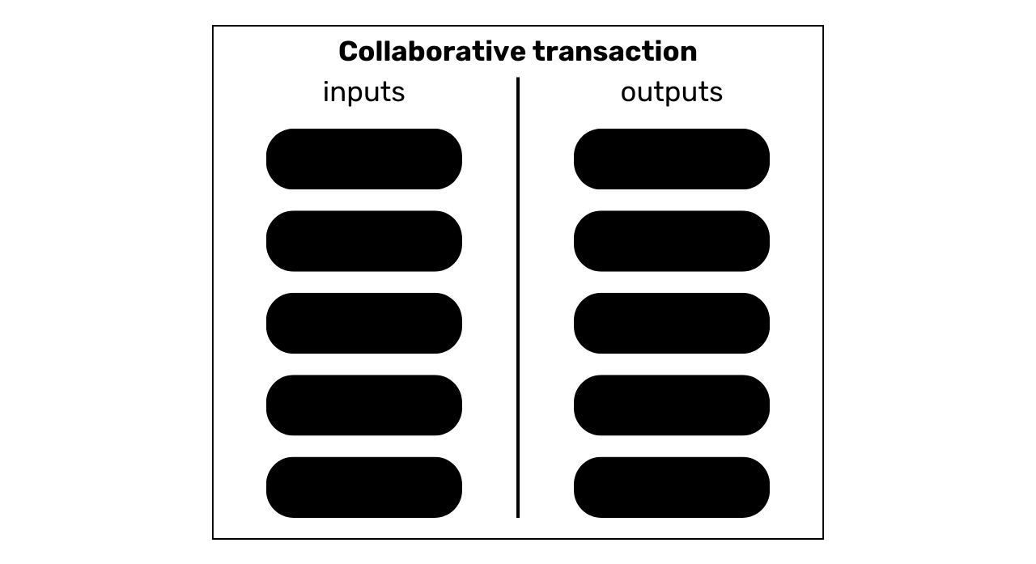
Collaborative transaction
inputs
outputs

Slide 39
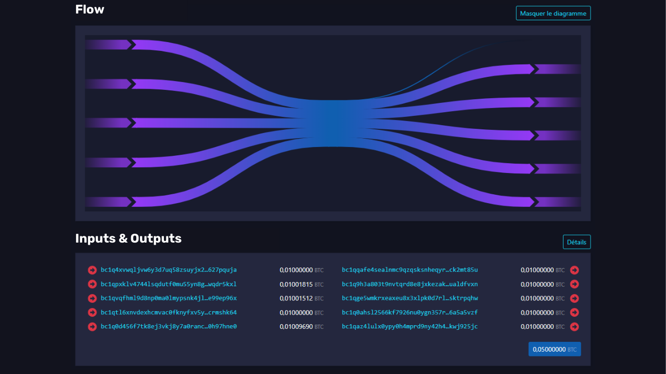

Slide 40
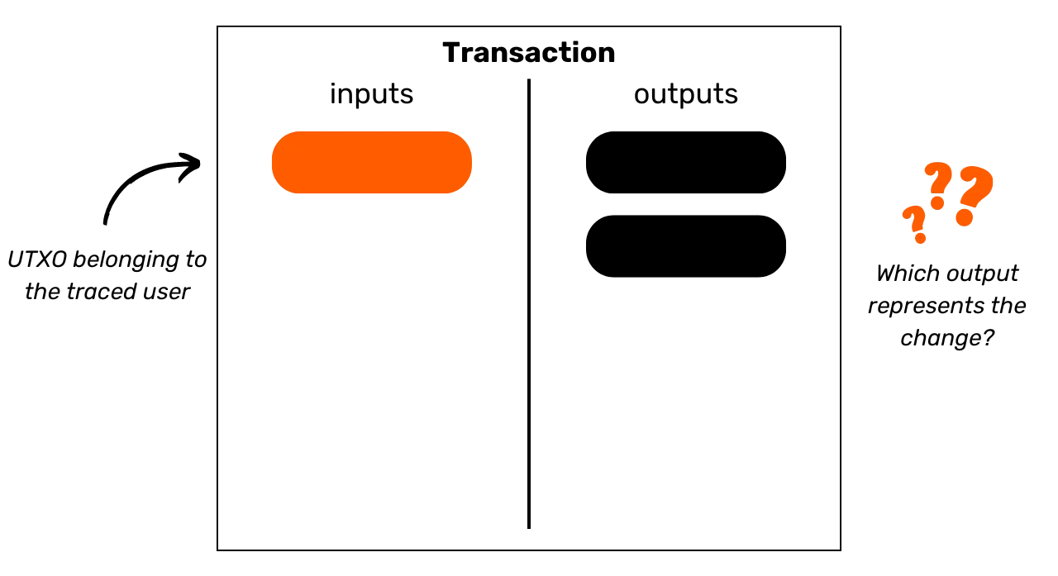
Transaction
inputs
outputs
UTXO belonging to
the traced user
Which output
represents the change?

Slide 41
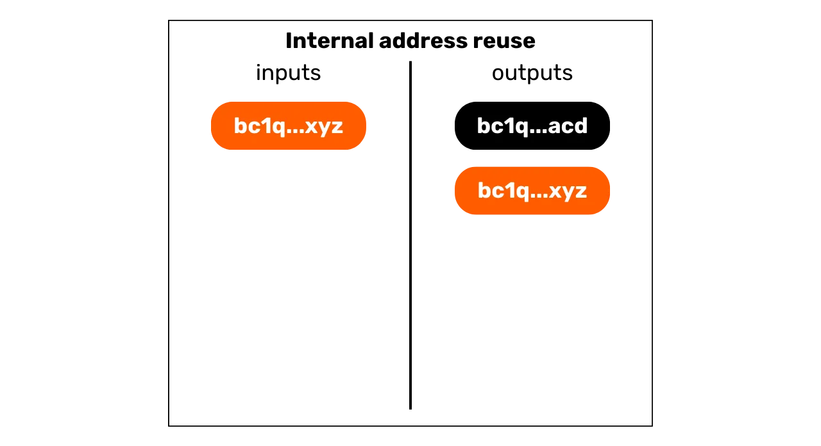
Internal address reuse
inputs
outputs

Slide 42
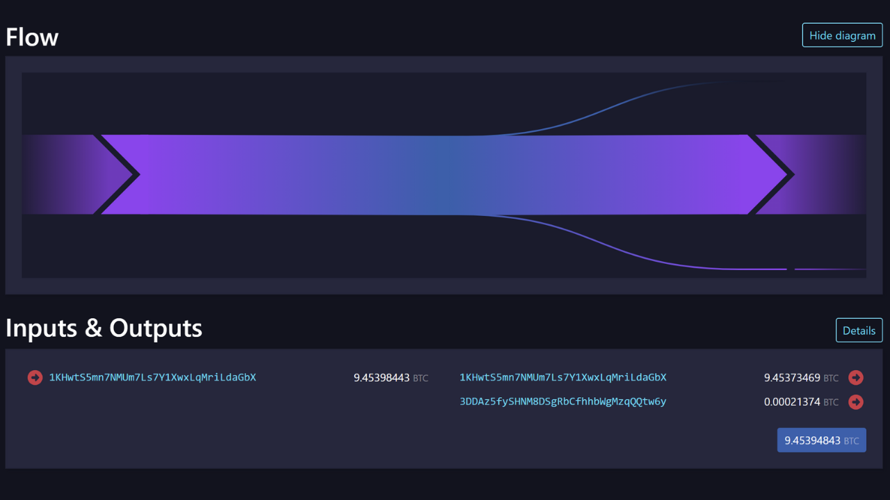

Slide 43
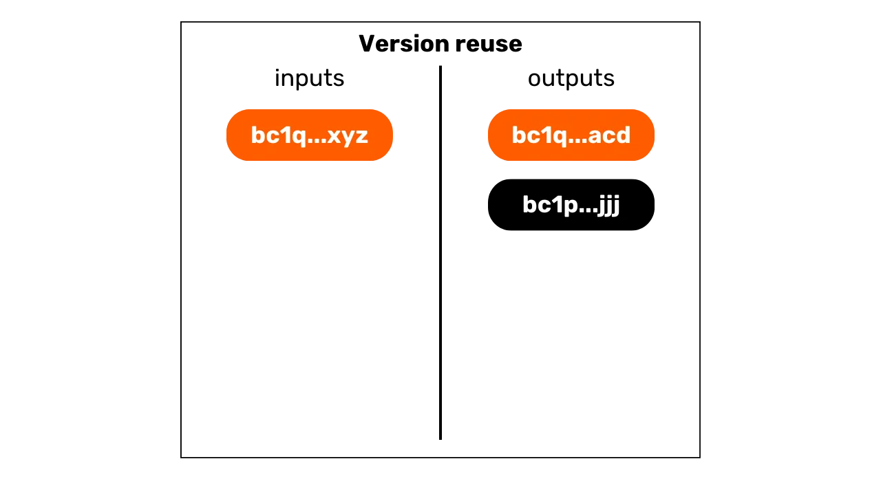
Version reuse
inputs
outputs

Slide 44
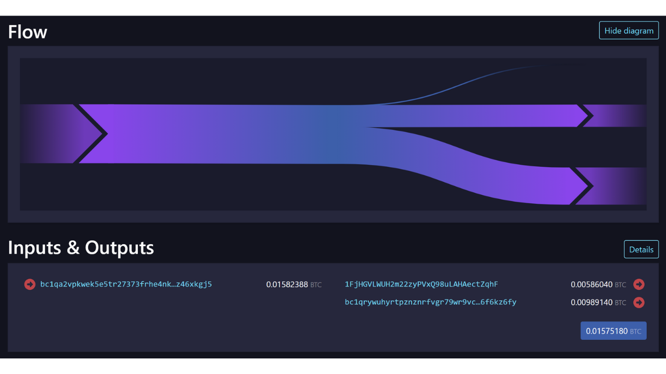

Slide 45
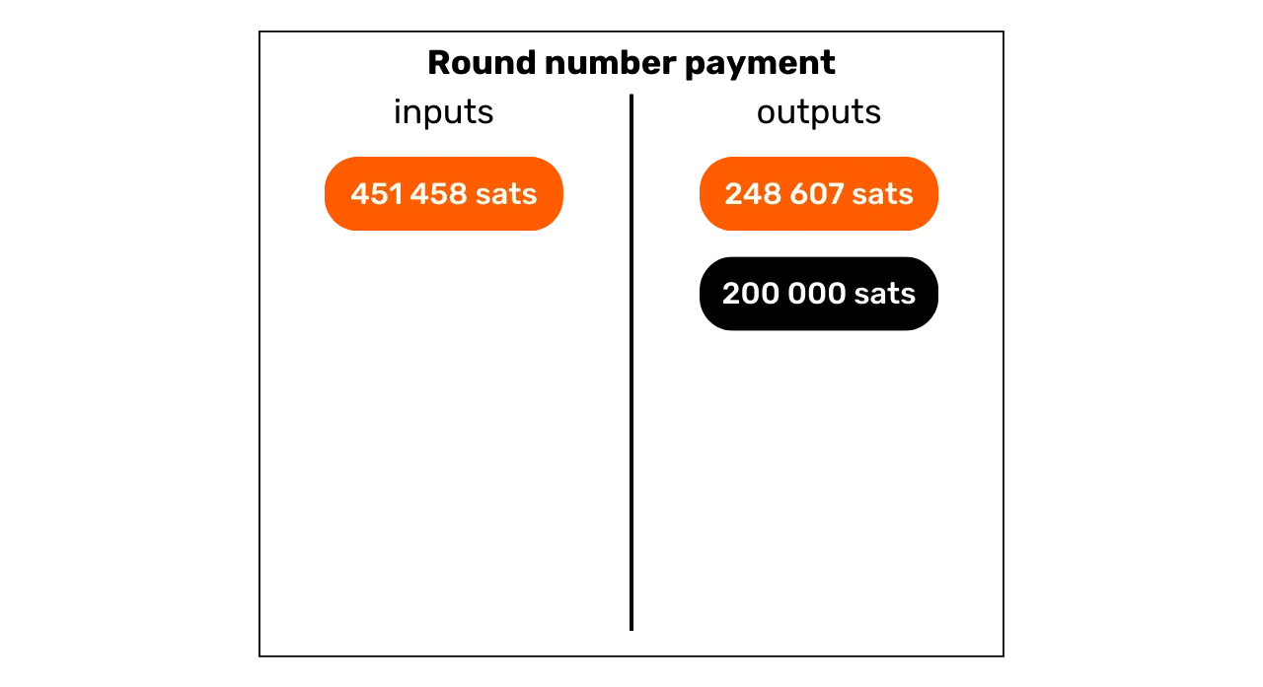
Round number payment
inputs
outputs

Slide 46
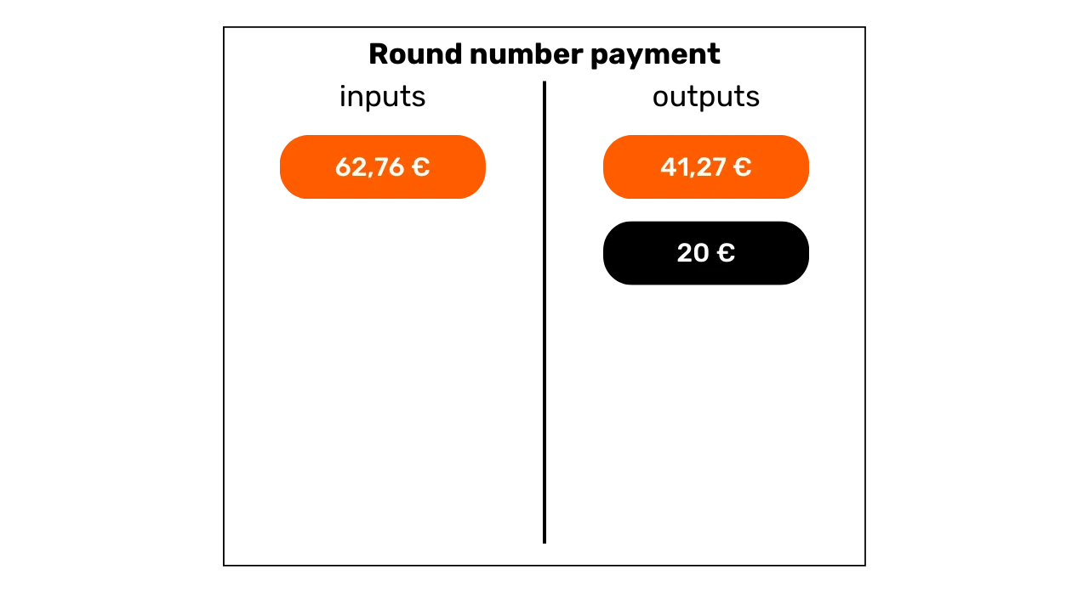
Round number payment
inputs
outputs
inputs

Slide 47
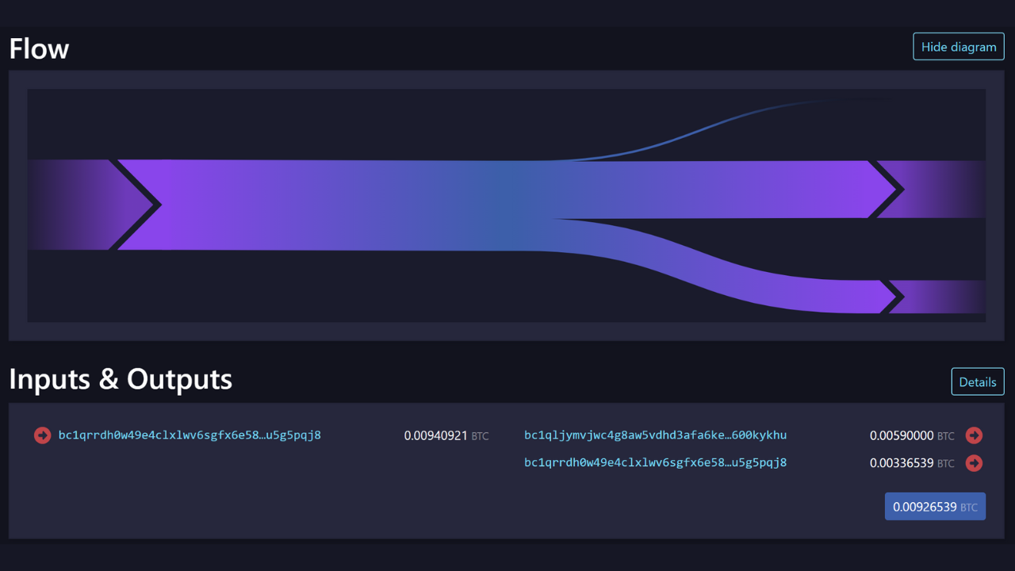

Slide 48

Largest output
inputs
outputs

Slide 49
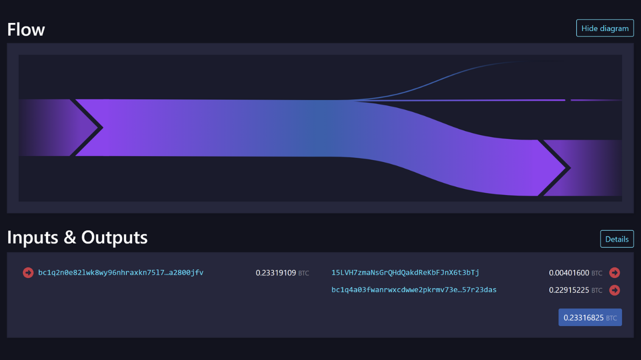

Slide 50
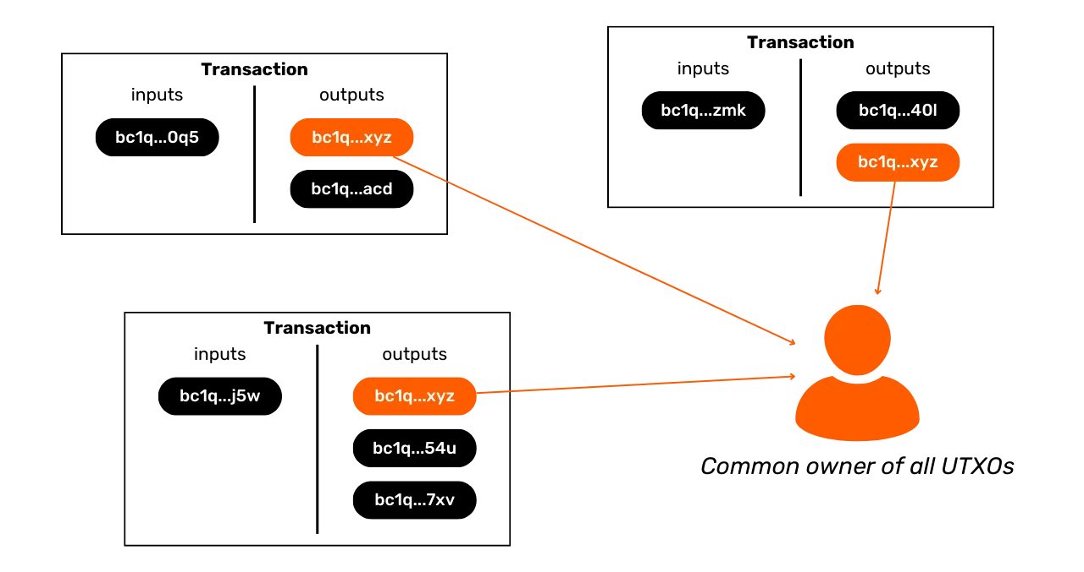
Transaction
Transaction
inputs
outputs
inputs
outputs
Transaction
inputs
outputs
Common owner of all UTXOs

Slide 51
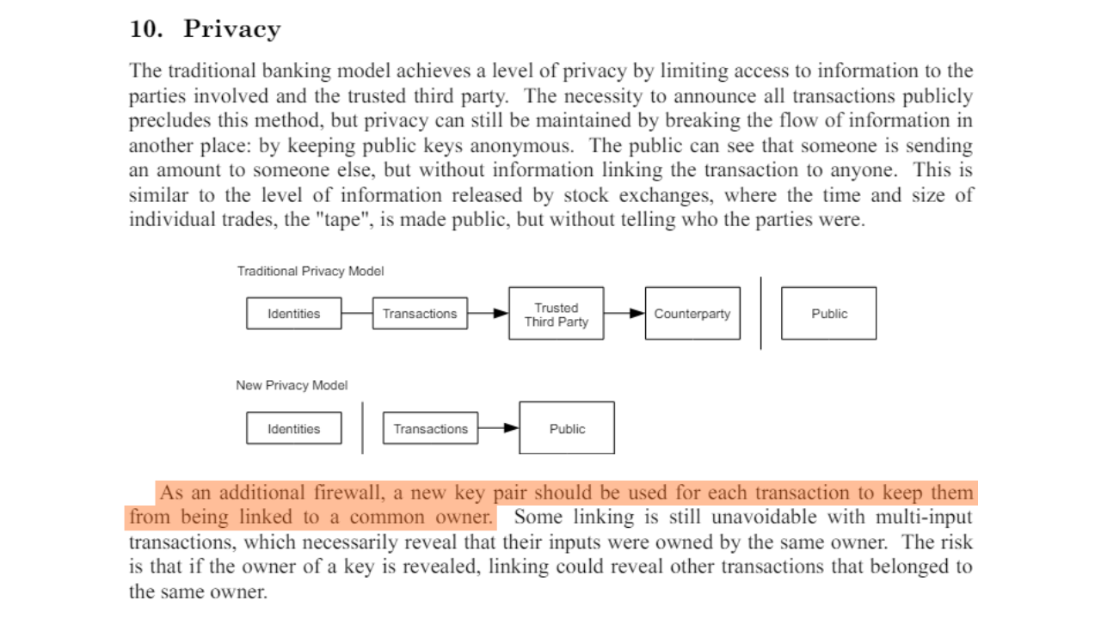

Slide 52


Slide 53

Transaction
Transaction
inputs
outputs
inputs
outputs
“sequence”:
“sequence”:
Transaction
inputs
outputs
“sequence”:
Same sender for all transactions?

Slide 54

Hi, I use Bitcoin. Here is my address:

Slide 55


Slide 56

Hi, I use Bitcoin. Here is my address:

Slide 57


Slide 58

Transaction
inputs
outputs

Slide 59

Tweaked public key
Classic Public Key
Merkle Root

Slide 61
Transaction
Transaction
inputs
outputs
inputs
outputs
Transaction
inputs
outputs
Common owner of all UTXOs

Slide 62
Internal address reuse
inputs
outputs

Slide 63


Slide 64


Slide 65

inputs
outputs
Change

Slide 66

Wallet
Labels
UTXO
Change sofa purchase
Exchange.com withdrawal
Customer Payment David
Change computer purchase
P2P purchase Charles
P2P Purchase Alice

Slide 67

Wallet
Labels
UTXO
NO KYC – Change sofa purchase
KYC - Exchange.com withdrawal
KYC – Customer payment David
NO KYC – Change computer purchase
NO KYC – P2P purchase Charles
NO KYC – P2P purchase Alice

Slide 68


Slide 69

inputs
outputs

Slide 70

Transaction
inputs
outputs
Transaction
Transaction
Transaction

Slide 71

UTXOs
inputs
outputs

Slide 73


Slide 74


Slide 75


Slide 76


Slide 77


Slide 78


Slide 79


Slide 80


Slide 81


Slide 82


Slide 83


Slide 84


Slide 86


Slide 87


Slide 88


Slide 89

inputs
outputs
inputs
outputs

Slide 90

inputs
outputs
inputs
outputs

Slide 91

Average fees in sats/vb

Slide 92
inputs
outputs

Slide 93

UTXOs
inputs
outputs

Slide 94


Slide 95


Slide 96


Slide 97

inputs
outputs

Slide 98
Banking System privacy model:
Identities
Bank
Counterparty
Bitcoin privacy model:
Identities
Transactions
Public

Slide 99


Slide 100

inputs
outputs

Slide 101
inputs
outputs

Slide 102

inputs

Slide 103

inputs
outputs

Slide 104

inputs
outputs
inputs
outputs

Slide 105

inputs
outputs
inputs
outputs

Slide 106

inputs
inputs

Slide 107

inputs
inputs

Slide 108

inputs
inputs

Slide 110


Slide 111


Slide 112


Slide 113


Slide 114

inputs + blinded output

Slide 115

inputs + blinded output
blind signature

Slide 116

inputs + blinded output
blind signature

Slide 117

inputs + blinded output
Blind signature
blind signature
unblinded output + signature

Slide 118

inputs + blinded output
Blind signature
blind signature
unblinded output + signature
unsigned transaction

Slide 119

inputs + blinded output
blind signature
unblinded output + signature
unsigned transaction
transaction signature

Slide 120


Slide 121


Slide 122


Slide 123

inputs
outputs

Slide 124

pre-mix
post-mix

Slide 125

wallet
inputs
outputs

Slide 126


Slide 127


Slide 128


Slide 129


Slide 130

inputs
outputs

Slide 131

inputs
outputs

Slide 132


Slide 133

inputs
outputs

Slide 134

inputs
outputs

Slide 135

inputs
outputs

Slide 136

inputs
outputs

Slide 137


Slide 138

inputs
outputs

Slide 139

Master Key
Purpose
Currency type
Accounts
Chains
Adresses

Slide 140

inputs
outputs
Coin entering
coinjoin cycles
Equalized
UTXOs ready
To be mixed
Service fee
Service fee
Doxxic
change
Tx0 mining fee

Slide 141

Inputs & outputs

Slide 142

inputs
outputs

Slide 143

inputs
outputs
inputs
outputs

Slide 144

premix
inputs
outputs
postmix

Slide 145


Slide 146

The analyst knows this coin
UTXO before
coinjoins
Coinjoin
cycles
UTXO after
coinjoins
The analyst wants to find this coin

Slide 147

The analyst knows this coin
UTXO before
coinjoins
Coinjoin
cycles
UTXO after
coinjoins
The analyst wants to find this coin

Slide 148

The analyst knows this coin
Probable UTXO
Probable UTXO
UTXO before
coinjoins
Coinjoin
cycles
Probable UTXO
Probable UTXO
Probable UTXO
The analyst is faced with a group of coins
that can all correspond

Slide 149

Remix UTXO
MIXED
Remix UTXO
MIXED
MIXED
Remix UTXO
MIXED
TXO UTXO
MIXED
TXO UTXO
MIXED
TXO UTXO
MIXED
TXO UTXO
MIXED
TXO UTXO
MIXED
TXO UTXO
MIXED
Remix UTXO
MIXED
Remix UTXO
MIXED
Remix UTXO
MIXED
Remix UTXO
MIXED
Remix UTXO
MIXED
Remix UTXO
MIXED
Forward Anonset

Slide 150

Probable UTXO
Probable UTXO
Probable UTXO
UTXO before
coinjoins
Coinjoin
cycles
Probable UTXO
Probable UTXO

Slide 151

The analyst knows this coin
Probable source
Probable source
Probable source
Coinjoin
cycles
UTXO after
coinjoins
Probable source
Probable source
The analyst is faced with a group of coins that can all be the source

Slide 152


Slide 153

Probable source
Probable source
Probable source
Coinjoin
cycles
UTXO after
coinjoins
Probable source
Probable source

Slide 154

inputs
outputs

Slide 155

inputs
outputs

Slide 156

inputs
outputs

Slide 157

Flow
Inputs & outputs

Slide 158


Slide 159


Slide 160

inputs
outputs

Slide 161

inputs
outputs

Slide 162

inputs
outputs
inputs
False!

Slide 163

inputs
outputs

Slide 164

inputs
outputs
Payment amount
False!

Slide 165

inputs
outputs
Actual payment of 4.000 sats

Slide 166


Slide 167


Slide 168

inputs
outputs

Slide 169

inputs
outputs

Slide 170

inputs
outputs

Slide 171

inputs
outputs

Slide 172

inputs
outputs

Slide 173

inputs
outputs

Slide 174

inputs
outputs

Slide 175

inputs
outputs

Slide 176

inputs
outputs
inputs
outputs

Slide 177

inputs
outputs

Slide 178


Slide 179


Slide 180


Slide 181

The sender makes 4 transactions to himself

Slide 182

The sender makes 4 transactions to himself
The last transaction allows the final receiver to be paid

Slide 183


Slide 184

It is not him anymore
It is surely him
The coinjoin does not come from my client
Is it still my client?
It is my client

Slide 185


Slide 186


Slide 187


Slide 188


Slide 189


Slide 190


Slide 191


Slide 192


Slide 193


Slide 194

SWAP

Slide 195

SWAP
Hacking

Slide 196


Slide 197

WALLET

Slide 198

WALLET

Slide 199

WALLET

Slide 200

WALLET

Slide 201

WALLET

Slide 202

WALLET

Slide 203

WALLET

Slide 204


Slide 205


Slide 206


Slide 207


Slide 208

Payment code

Slide 209

Master Key
Purpose
Currency type
Accounts
Chains
Addresses

Slide 210


Slide 211


Slide 212


Slide 213


Slide 214

Exchange on an
unsecured network
Shared secret

Slide 215


Slide 216

Common painting
Secret painting
Secret painting
Public exchange
Secret paintings
Shared price

Slide 217


Slide 218


Slide 219

“Hello! Here is my payment code. I will send you payments with BIP47”
v
Transaction
notification

Slide 220

Classic Bitcoin privacy model:
BIP47 payment code privacy model:

Slide 221

Shared secret
Master key
Payment code
Encrypted
Payment code
Payment code
Payment code
Private key
Public key
Address
Transaction notification
Notification address
Child public key
Deriving child keys
Bitcoin transaction
Address derivation

Slide 222


Slide 223

Point G of the
Elliptical curve
Insecure public
Transportation (Bitcoin)

Slide 224

Shared secret
Shared secret
Payment code
Encrypted
Payment code
Payment code
Master Key
Transaction notification
Notification address
Public key
Public Key
Identify the notification
Identify the public key of the first input

Slide 225

Master Key
Payment code
Payment code
Notification address
Other private key
BIP47
First payment
Payment address K0
Other private key
Other public key
Other address
Payment address
Deriving child keys
Bitcoin transaction
Adding points on elliptic curves
Address derivation

Slide 226

Master Key
Payment code
Payment code
Payment code
Notification address
Payment address K0
Other private key
Other private key
BIP47
First payment
Payment address K1
Other address
Deriving child keys
Adding points on elliptic curves
Bitcoin transaction
Bitcoin transaction

Slide 227


Slide 228

Payment code
Payment code
Master Key
Notification address
Payment address K0
Payment address K1
Deriving child keys
Adding points on elliptic curves
Public Key derivation
Address derivation

Slide 229

Secret
Secret
Abscissa of secrecy
Hash your secret
Bob’s private key
Point G of the curve
BIP47 private
payment key
Bob’s public key
BIP47 public payment key

Slide 230

Payment code
Payment code
Master Key
Notification address
Address K0
First repaiment
Other address
Other public key
Other private key
Deriving child keys
Bitcoin transaction
Adding points on elliptic curves
Address derivation

Slide 231


Slide 232


Slide 233


Slide 234

Transaction
inputs
outputs
inputs
inputs
Change

Slide 235


